Slide 1
BioJava

Slide 2
CONTENTS
Introduction
Installation
Symbols
Sequence Manipulation
DNA to RNA
Reverse Complement
Translation
DNA to Protein
Codon to Protein
References

Slide 3
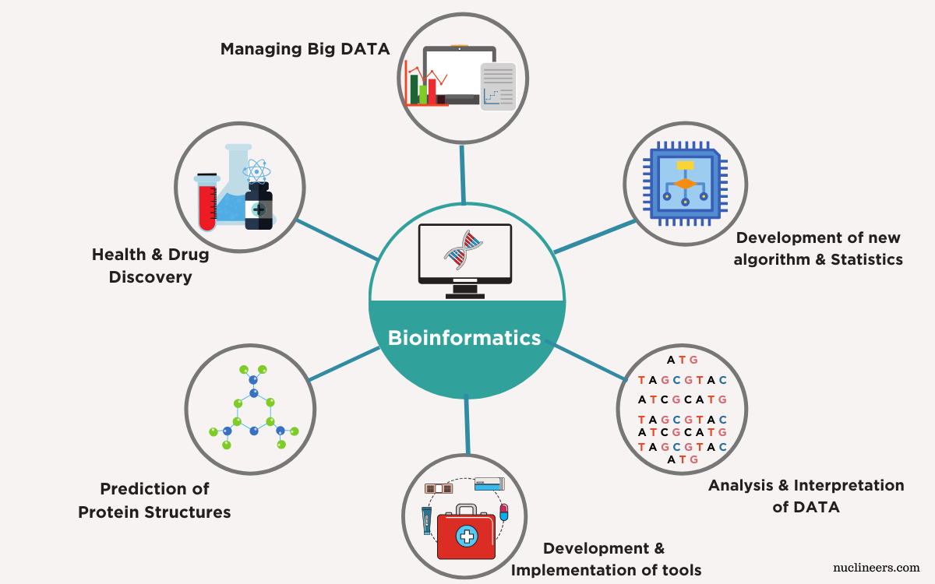

Slide 4


Slide 5
List of Languages used in Bioinformatics
Biojava(Very popular language because of its strong oops and performance till now)
Bioperl(First Bioinformatics tool developed by sanger)
Biopython(Recently many people started using biopython because of its simplicity)

Slide 6
BioJava: Introduction
Introduced by Thomas Down and Matthew Pocock in 1999 as an API
The BioJava Project is an open-source project dedicated to providing Java tools for processing biological data.
The BioJava library is useful for automating those daily and tedious bioinformatics tasks.
In October 2012,the first paper on Biojava was published.

Slide 7
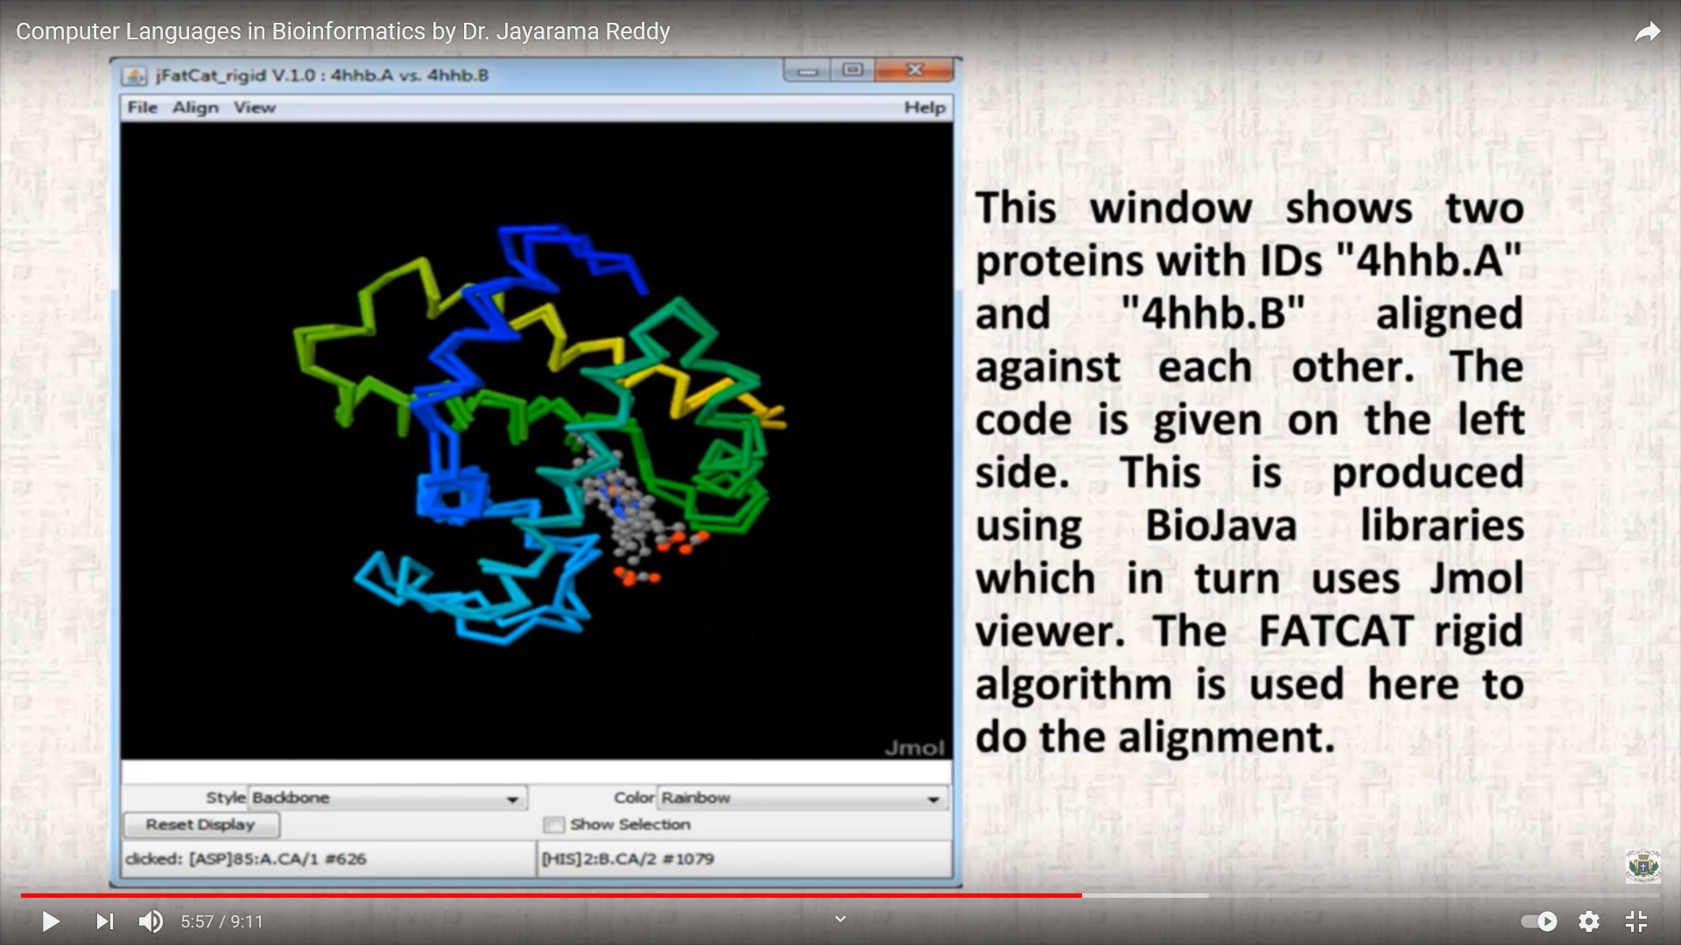
Software application:

Slide 8
BioJava: Installation
https://biojava.org/wiki/BioJava%3ADownload_4.2.0/
None of these .jar files need to be unpacked for normal use – simply place them in a convenient directory.
It does not require installation but requires importing packages.

Slide 9
BioJava:Uses
Fundamental of accessing biological sequence data
manipulating sequences
Translation of any sequences
Perform basic operation on biological sequences

Slide 10
BioJava:Packages

Slide 11
BioJava: Symbols
The set of Symbol objects which may be found in a particular type of sequence data are defined in an ‘Alphabet’.

Slide 12
Alphabet
In BioJava Alphabets are collections of Symbols.
Common biological alphabets (DNA, RNA, protein etc) are registered with the BioJava AlphabetManager at startup and can be accessed by name.
The DNA, RNA and protein alphabets can also be accessed using convenient static methods from DNATools, RNATools and ProteinTools respectively.

Slide 13
BioJava: Aplhabets Syntax
org.biojava.bio.symbol.*;
org.biojava.bio.seq.*;
Alphabet dna;
dna = AlphabetManager.alphabetForName("DNA");
or
dna = DNATools.getDNA();

Slide 14
SymbolList
The basic interface for sequence data in biojava is SymbolList.
Every SymbolList has an associated Alphabet, and may only contain Symbols from that alphabet.
SymbolLists can be seen as strings which are made up of Symbol objects rather than characters.
The interface specifies methods for querying the alphabet and length, and accessing the Symbols:
Syntax:
//create a DNA SymbolList from a String
SymbolList dna = DNATools.createDNA("atcggtcggctta");

Slide 15
Sequence
Sequence is a sub-interface of SymbolList. Thus, all the standard methods for accessing sequence data in a SymbolList can equally be applied to a Sequence, and Sequences can be passed to any analysis methods which normally expect to receive a SymbolList.
The Sequence interface adds two types of additional data to a SymbolList.
Global annotations, such as names, database identifiers, and literature references
Location-specific annotations (features)

Slide 16
Sequence
Syntax:
//create a DNA sequence with the name dna_1
Sequence dna = DNATools.createDNASequence("atgctg", "dna_1");

Slide 17
Subsection of a Sequence?
Getting a Sub - Sequence
SymbolList symL = DNATools.createDNA("atcggtcggctta");
//code here to generate a SymbolList get the first Symbol
Symbol sym = symL.symbolAt(1);
//get the first three bases
SymbolList symL2 = symL.subList(1,3);
//get the last three bases
SymbolList symL3 = symL.subList(symL.length() - 3, symL.length());

Slide 18
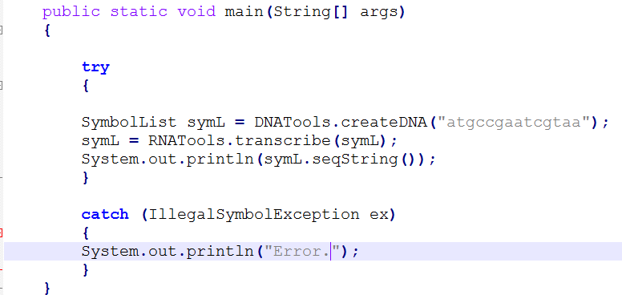
BioJava: Sequence Manipulation (Transcription)
Explanation with example:

Slide 19
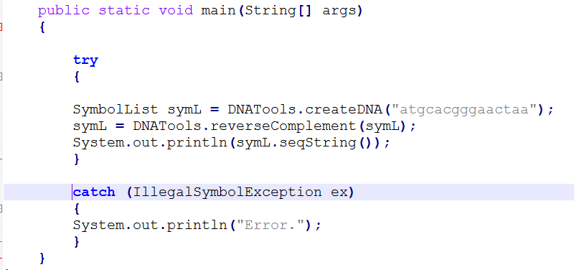
BioJava: Sequence Manipulation (Reverse Complement)
Explanation with example:

Slide 20
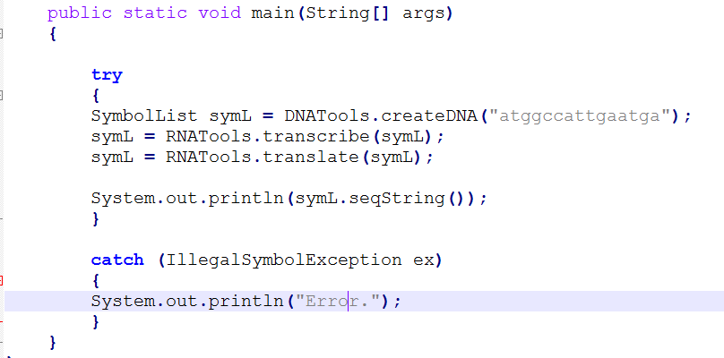
BioJava: Translation (DNA to Protein)
Explanation with example:

Slide 21
LOCATION
In BioJava locations in a Sequence are specified by simple objects that implement the interface Location.
How do I specify a PointLocation?
A point location is the inclusive location of a single symbol in a SymbolList or Sequence.
PointLocations have public constructors and are easy to instantiate.
That BioJava uses the biological coordinate system thus the first PointLocation in a Sequence will be 1 not 0.

Slide 22
Ex:
import org.biojava.bio.symbol.*;
import org.biojava.bio.seq.*;
public class SpecifyPoint {
public static void main(String[] args) {
try {
PointLocation point = new PointLocation(3);
System.out.println("Location: "+point.toString());
SymbolList sl = RNATools.createRNA("gcagcuaggcggaaggagc");
System.out.println("SymbolList: "+sl.seqString());
SymbolList sym = point.symbols(sl);
System.out.println("Symbol specified by Location:"+sym.seqString());
}
catch (IllegalSymbolException ex) {
ex.printStackTrace();
} } }

Slide 23
What is RangeLocation?
In BioJava a RangeLocation is an object that holds the minimum and maximum bounds of a region on a SymbolList or Sequence.
The minimum and maximum are inclusive.

Slide 24
import org.biojava.bio.symbol.*;
import org.biojava.bio.seq.*;
public class SpecifyRange {
public static void main(String[] args) {
try {
Location loc = LocationTools.makeLocation(3,8);
System.out.println("Location: "+loc.toString());
SymbolList sl = RNATools.createRNA("gcagcuaggcggaaggagc");
System.out.println("SymbolList: "+sl.seqString());
SymbolList sym = loc.symbols(sl);
System.out.println("Symbols specified by Location: "+sym.seqString());
}
catch (IllegalSymbolException ex) {
//illegal symbol used to make sl
ex.printStackTrace();
}
}
}

Slide 25
How do CircularLocations work?
CircularLocations are dealt with using the CircularLocation class.
CircularLocations are best constructed using the LocationTools class.
No limits are placed on indexing a CircularView and a special convention is used for numbering.

Slide 26
Feature
A bit like an Annotation with a Location.
Implement the Feature interface.
All Feature implementations contain an inner class
called 'Template’.
It specifies the minimum information needed to create
a Feature.
It holds all features in FeatureHolder interface.

Slide 27
Syntax:
StrandedFeature.Template templ = new StrandedFeature.Template();
//fill in the template
templ.annotation = Annotation.EMPTY_ANNOTATION;
templ.location = new RangeLocation(3,6);
templ.source = "my feature";
templ.strand = StrandedFeature.POSITIVE;
templ.type = "interesting motif";

Slide 28
Feature f = seq.createFeature(templ);
templ = (StrandedFeature.Template)f.makeTemplate();

Slide 29
Count:
Counting the residues in a Sequence is a fairly standard bioinformatics task.
Syntax:
Count c = new IndexedCount(alpha);

Slide 30
Distribution:
A Distribution is a map from a Symbol to a frequency.
Distributions are trained with observed Symbols using a DistributionTrainerContext.
A DistributionTrainerContext can train several registered Distributions and will handle any Symbol from any Alphabet

Slide 31
REFERENCES
BioJava: an open-source framework for bioinformatics, Andreas Prlic; Andrew Yates; Spencer E. Bliven; Peter W. Rose; Julius Jacobsen; Peter V. Troshin; Mark Chapman; Jianjiong Gao; Chuan Hock Koh; Sylvain Foisy; Richard Holland; Gediminas Rimsa; Michael L. Heuer; H. Brandstatter-Muller; Philip E. Bourne; Scooter Willis Bioinformatics (2012) 28 (20): 2693-2695.
BioJava Official Page (http://biojava.org/)

Slide 32
Thank You

